Slide 1
GDPR Impacts
SEV GDPR Workshop – Athens
Giles Watkins, UK Country Leader
Wednesday 7th February, 2018

Slide 2
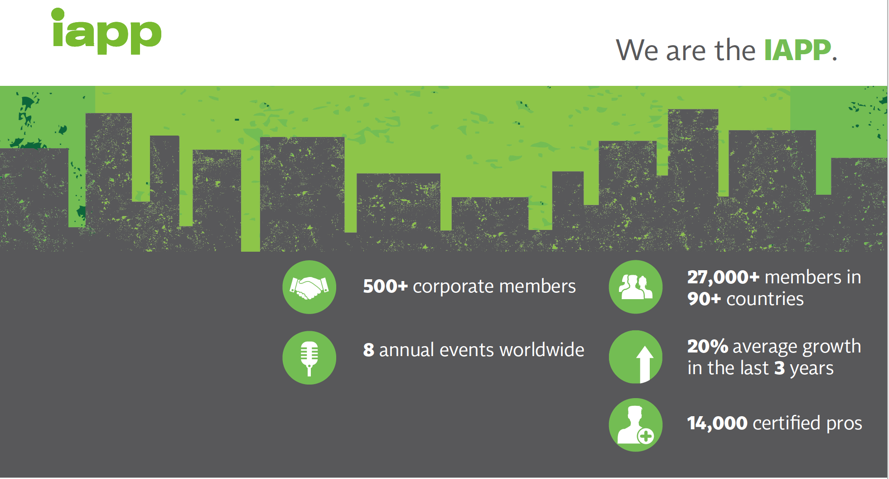

Slide 3
Agenda
What is the ‘Privacy Opportunity’?
What is different under GDPR?
Where organisations are focusing?
What can you do in the next 100 days?

Slide 4
What is The
‘privacy opportunity’?

Slide 5
The Data Economy 2.0…..
Businesses and society are experiencing benefits from massive data generation
Easy access to personal information results in new customer insights and business growth opportunities
Companies must balance these benefits against potential privacy risks
5

Slide 6
The size of the opportunity
CISCO – ‘Internet of Everything’ represents $19Trillion opportunity
    $14 Trillion in Privacy sector
    $5Trillion in the Public sector
General Electric - IoT investment to exceed $60 Trillion
IHS – 75 Billion connected devices by 2025
LSE – Economic benefit of personal data over € 1 Trillion by 2020 in Europe alone
Data driven company valuations have soared…..
Notes:
Google –
Facebook
Uber - $65 Billion – pre-breach - now

Slide 7
But there are risks……
5 Biggest Data Breaches of 2017
    Dunn & Bradstreet – 33.7million unique records
    Republican National Committee – 198 million Americans
    Verizon – 14 million subscribers
    Uber – 57 million rider and driver accounts
    Equifax - estimated 143 million customers
And of all time….
    Anthem – 80 million records
    FriendFinder network – 413 million records
    Aadhar – 1 Billion records
    River City Media – 1.37 Billion records
Source: Information Is Beautiful

Slide 8
The impacts can be significant
Financial Impact
Regulatory Impact
Reputational Impact

Slide 9
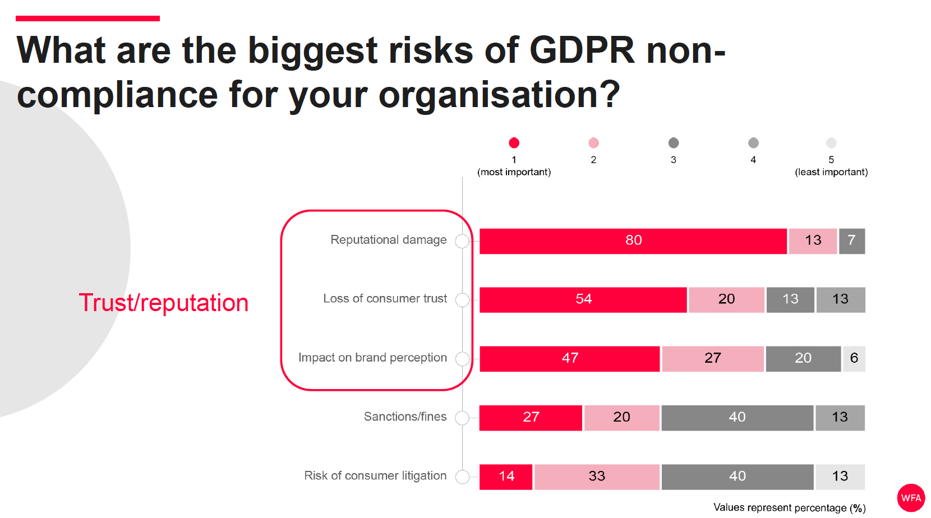
9

Slide 10
Ultimately, its about people
Four types of Privacy ‘harms’
  Intrusions
      “They” come into “your” space and contact you or tell you what to do
  Information collection
      “They” watch what you are doing, more than they should
  Information processing
      “They” have a lot of data, and do things with it
  Information dissemination
      “They” disclose data, perhaps more than “you” think they should

Slide 11
The Digital Trust Payoff
Businesses need to be confident in the integrity and availability of data and their right to use it
Citizens will migrate to businesses that work to develop and maintain trust
Trust (and Brand) are increasingly impacted by core disciplines of Privacy, Security and Identity
The rise of the Chief Trust Officer….. ?
© 2017 Pridium Ltd
11

Slide 12
What is different under gdpr?

Slide 13
What is different under GDPR
Applicability to non-EU Controllers
Data Privacy
Officer
Fines of 4% Global Turnover or €20m
Processors Liability
72 hour Breach Notification
Privacy By design
Privacy Impact Assessments
Transparent
Notice and Proactive Consent
Accountability
Additional Data
Subject Rights

Slide 14
Demonstrating Accountability
******
Demonstrate compliance by implementing appropriate technical and organisational measures
Implementing measures that meet principles of data protection by design and data protection by default
Maintain relevant documentation
Appoint a data protection officer, if appropriate

Slide 15
Data Protection Officer
Positioning in the company (Art. 38)
Proper and timely involvement in all relevant aspects to be ensured by the controller
Support by sufficient resources and access to data and systems and allowance of further qualification
Independence of instructions and protection against sanctioning by controller as employer
Point of contact for data subjects
Professional secrecy and interest protection

Slide 16
Data Protection Officer
Qualifications
Art. 37 (5): ‘The data protection officer shall be designated on the basis of professional qualities and, in particular, expert knowledge of data protection law and practices and the ability to fulfil the tasks referred to in Article 39.’

Slide 17
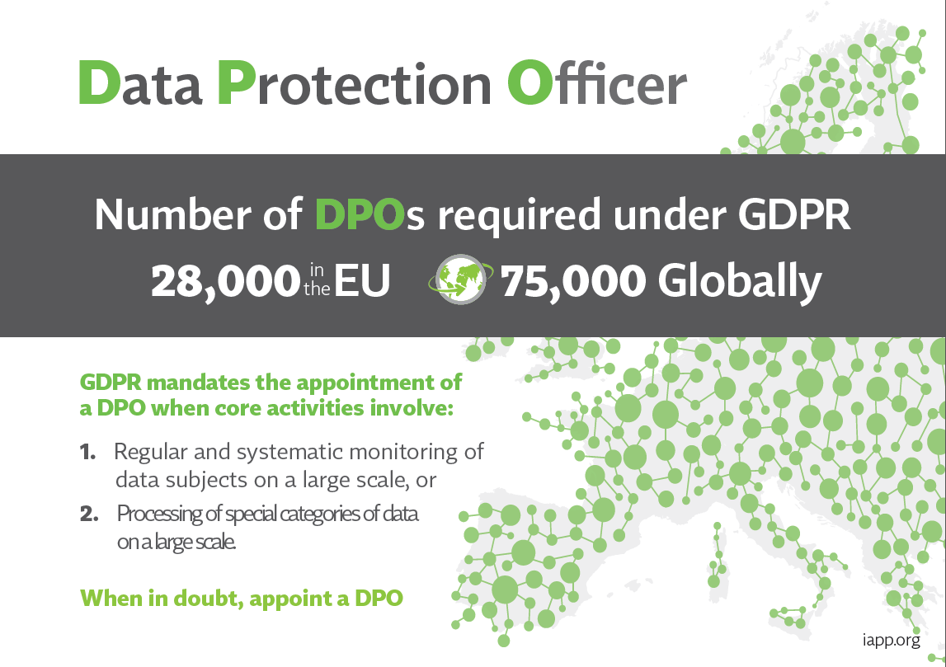
The growth of an industry

Slide 18
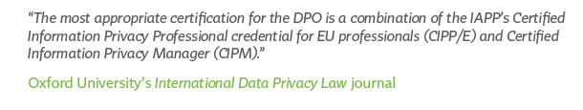



CIPP/E
EU laws and regulations
The global standard for the go-to person for privacy laws, regulations and frameworks
CIPM
Operations
The first and only privacy certification for professionals who manage day-to-day operations
CIPT
Technology
The first and only privacy certification for professionals who manage and build privacy requirements and controls in technology

Slide 19
What are organisations focussing on?

Slide 20
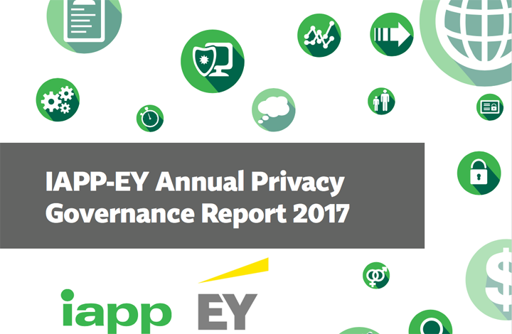

Slide 21
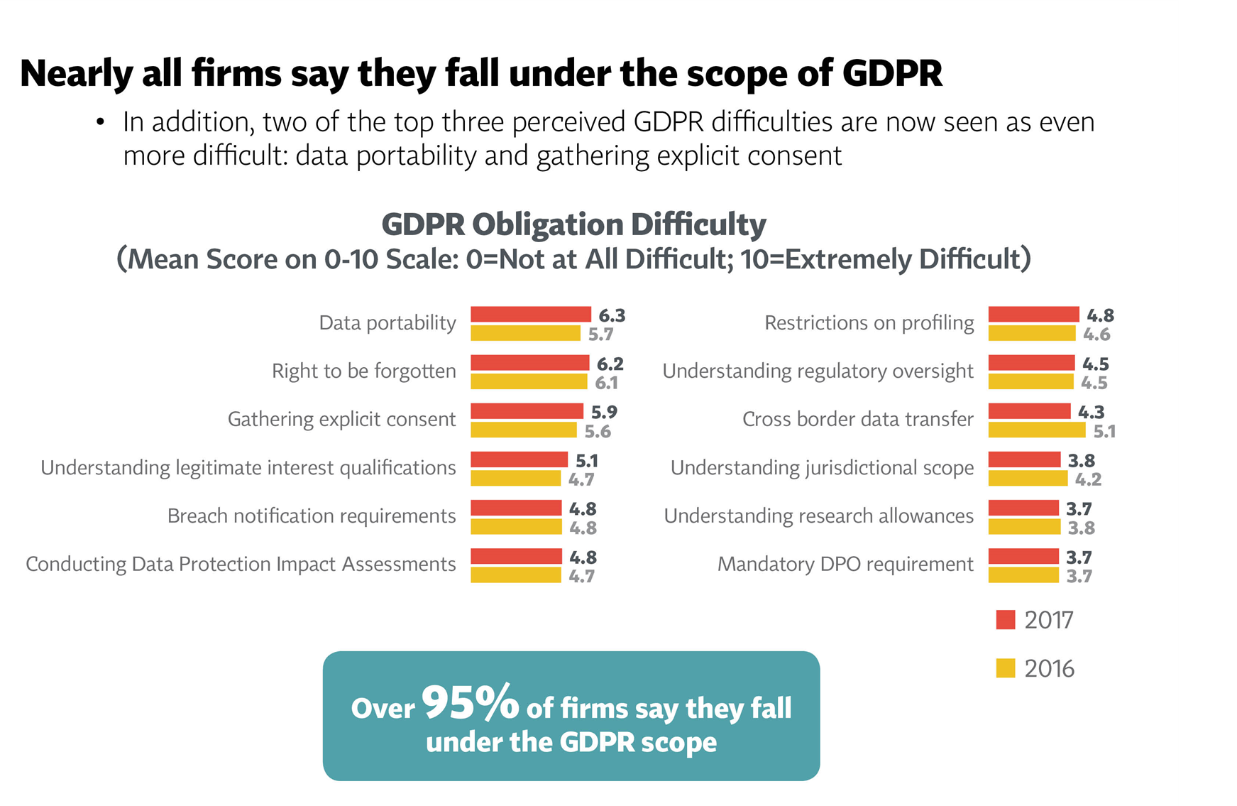

Slide 22
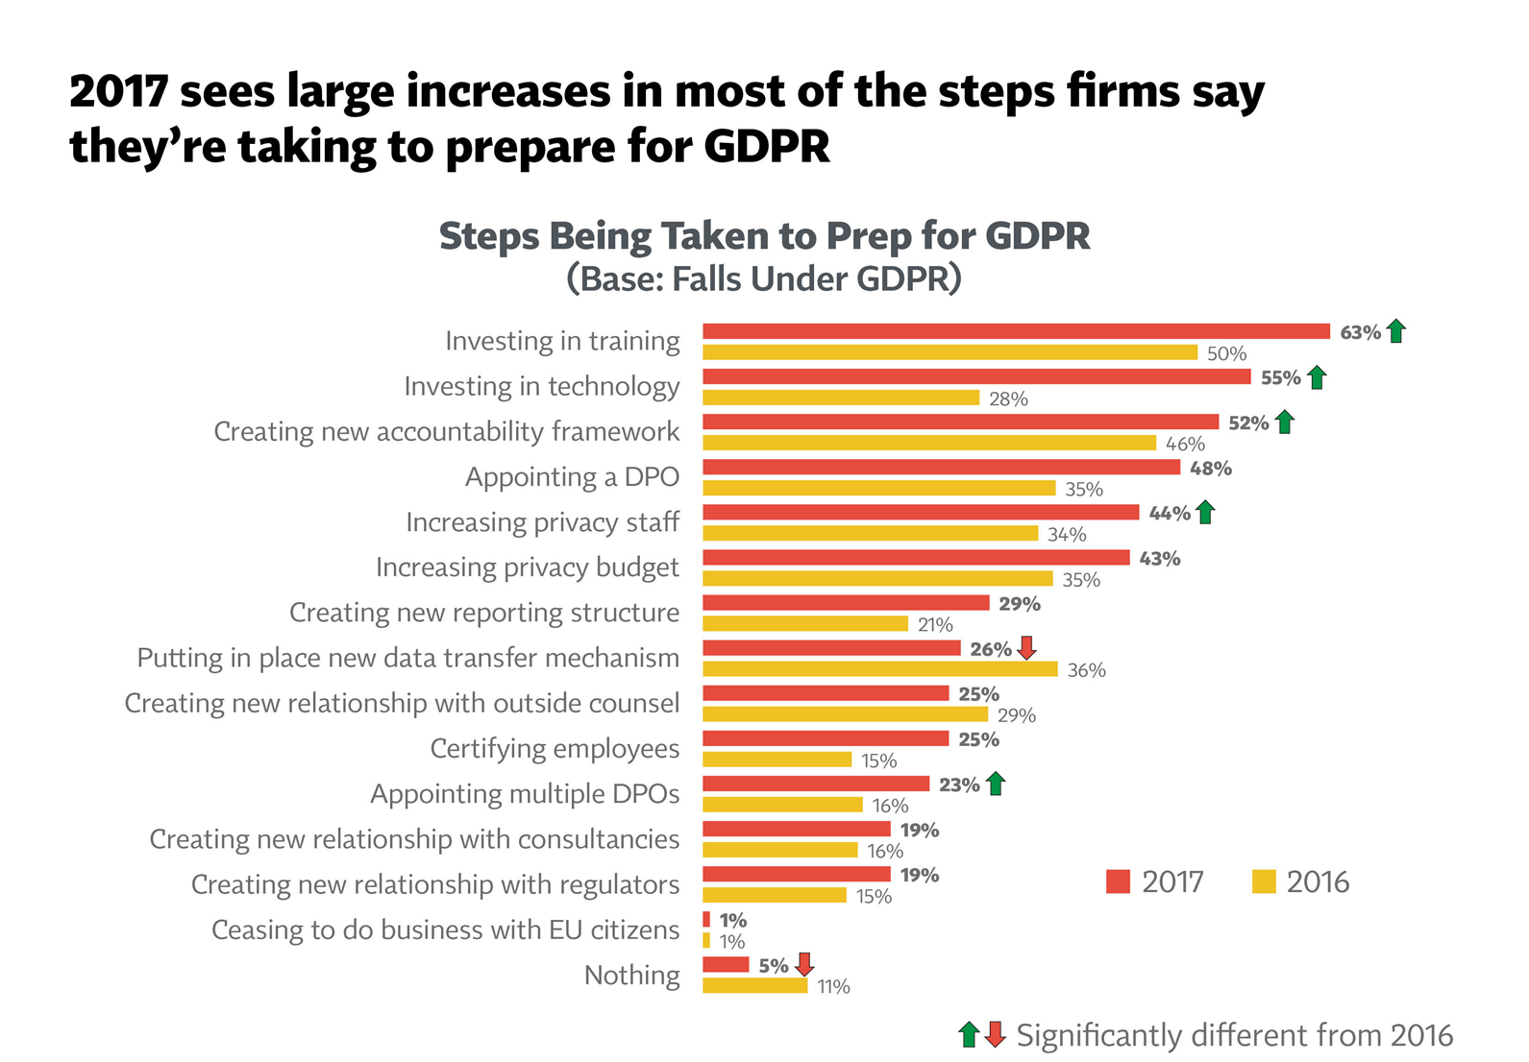

Slide 23
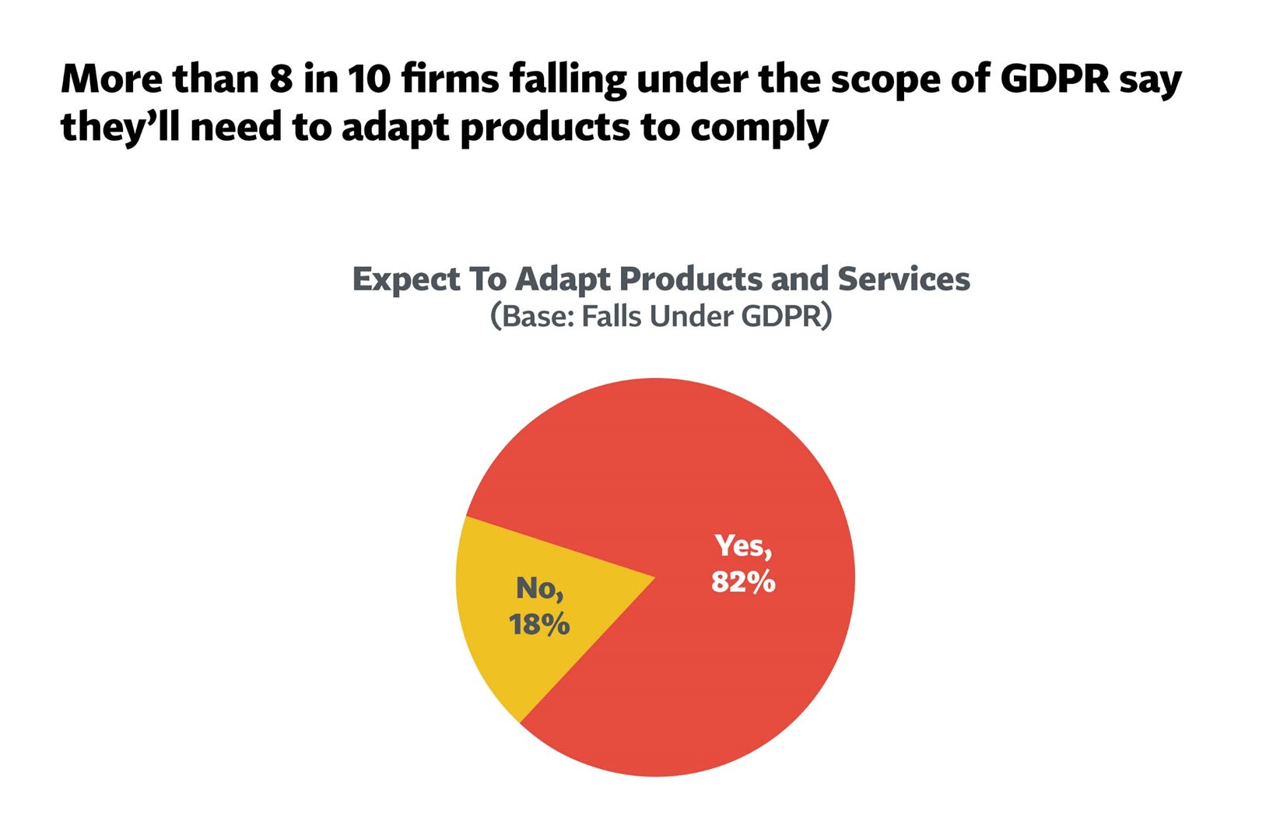

Slide 24
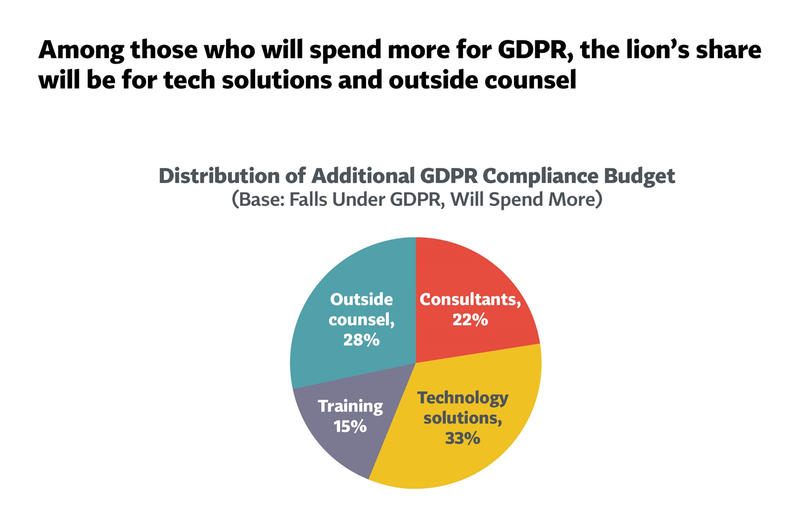

Slide 25
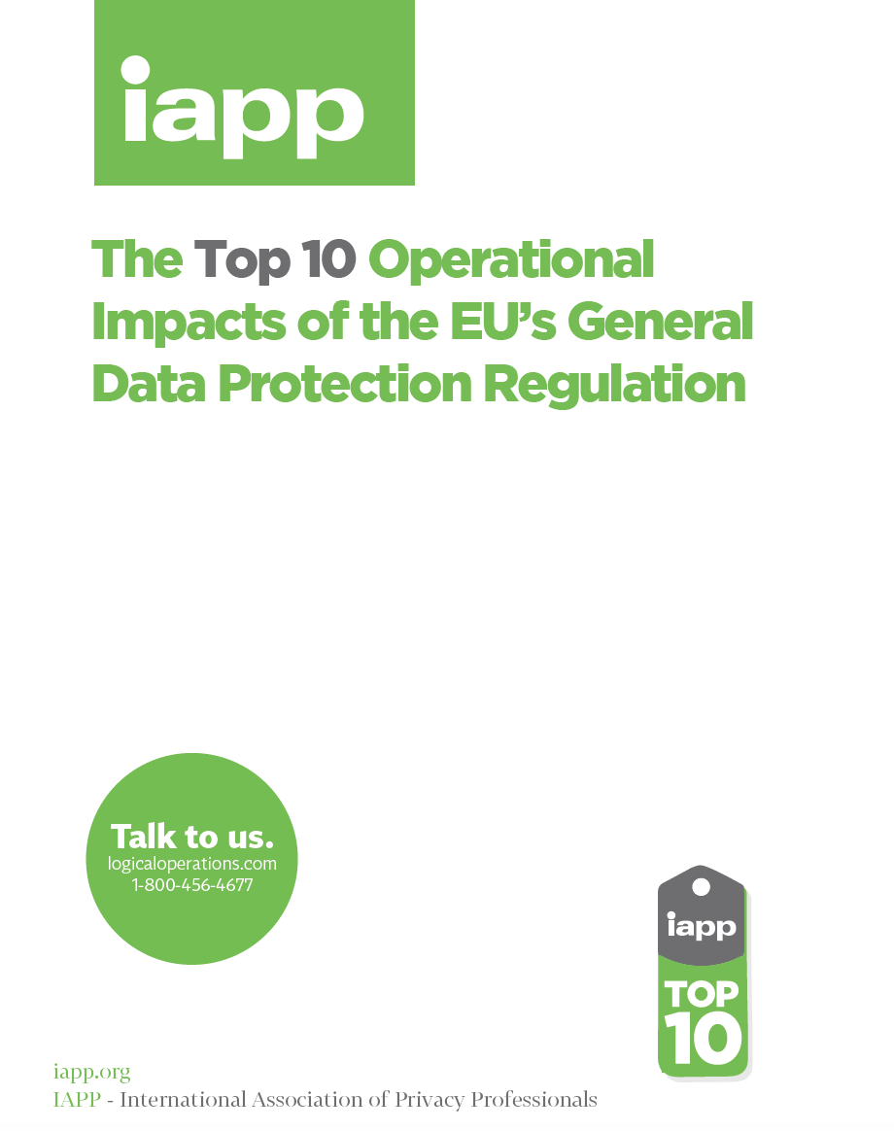
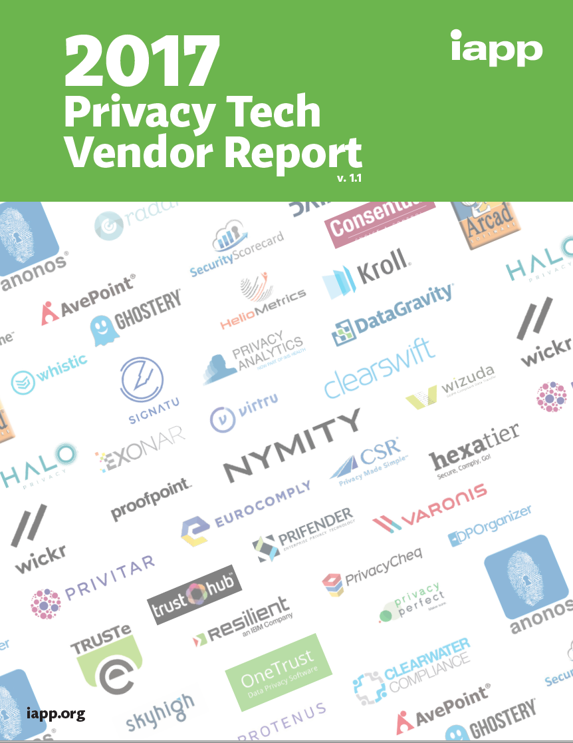
Sources of information
Notes:
Those surveyed said they expected a 57-percent increase in their non-salary budgets.
The mean privacy budget is $1.7 million, with 11 percent of that going towards technology
Organisations with more than 75,000 employees, spend an average of just under $500,000 annually on privacy technology solutions

Slide 26
What can you do in the next 100 days?

Slide 27






















GDPR COMPLIANCE PROGRAMS – COMMON FOCUS AREAS
D ATA
D ATA
DPIA (DATA PRIVACY
SECURIT Y
BREACH NOTIFICATION
INTERNATIONAL
INVENTORY
MAPPING
IMPACT ASSESSMENT)
TRANSFERS
100-Day
Focus
Areas
CONSENT
DATA PROTECTION
TRAINING AND
CONTRACT
CITIZENS RIGHTS PROCESSES
MECHANISM
OFFICER
AWARENESS
REVIEWS
27
Notes:
Consent
Freely given, specific, informed and unambiguous indication of
agreement, by a statement or by a clear affirmative action
Robust information disclosure requirements, including but not
limited to identity of controllers and the purposes of processing
Revocable as easily as it was to give consent in the first place
Obligation for controllers to be able to “demonstrate” consent,
e.g. through a record

Slide 28
Privacy Management Framework
Single approach to managing privacy within an organisation
Achieve consistency of approach and understanding across business functions and geographies
Facilitates risk analysis
Allows processes to be defined and maturity levels assessed and managed
Pridium Privacy Management Framework
© 2017 Pridium Ltd

Slide 29
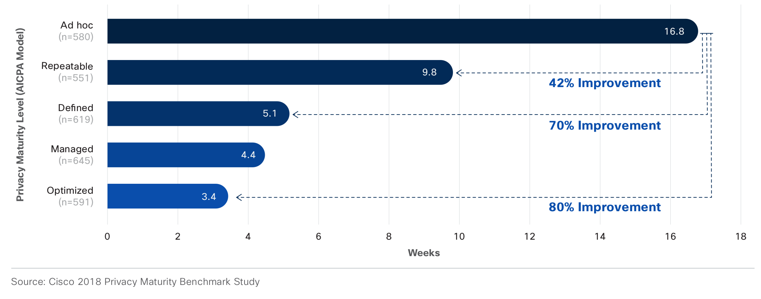
Privacy impact on sales

Slide 30
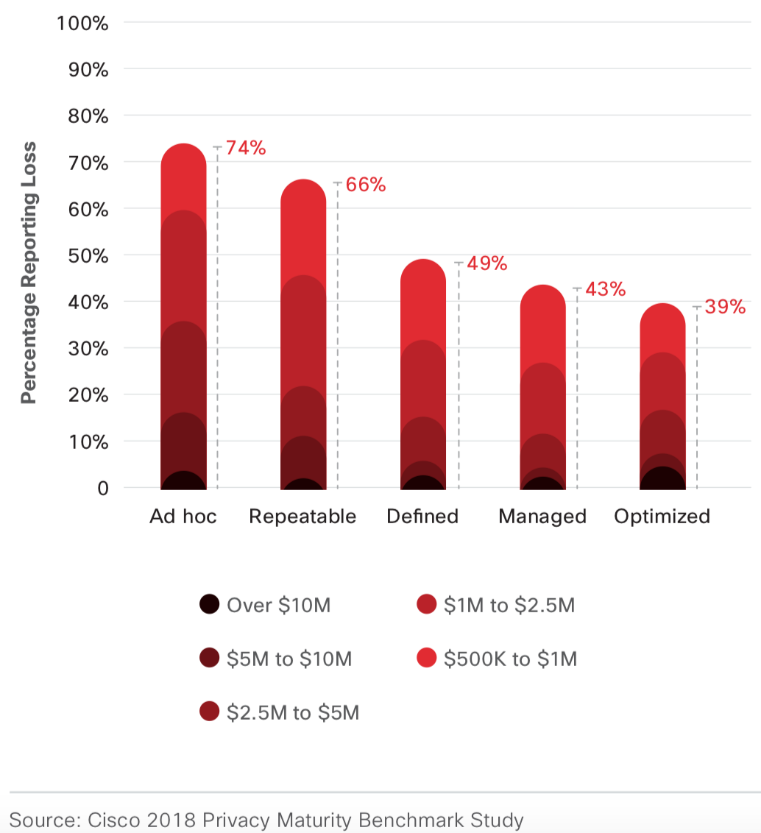
Privacy maturity impact on costs of data breaches

Slide 31
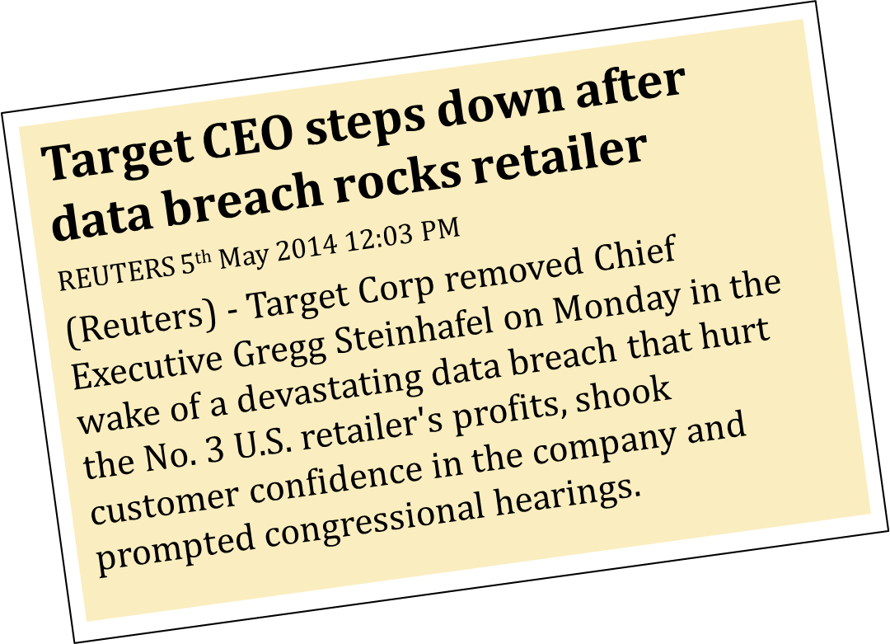
Who would you rather be?

Slide 32
For questions or to request
additional information:
Giles Watkins
UK Country Leader, IAPP
gwatkins@iapp.org
+44 (0) 7500 072 785
www.iapp.org

